Slide 1
TED TALKS
BY:
Kumkum Yadav
Garima Garg

Slide 2


INTRODUCTION

Slide 3
OBJECTIVE
Predicting number of views based on number of speakers, languages, duration and number of comments (PREDICTION 1)
Predicting the sentiments of ratings (rated as) based on description of comments by the users. (PREDICTION 2)

Slide 4




TOOLS USED

Slide 5
WHAT IS OUR DATASET?
Comments
Description
Duration
Event
Film Date
Languages
Main Speaker
Ratings
Related Talks
Speaker Occupation
Tags
Title
URL
Views
Name
Number of speakers
Published Date

Slide 6
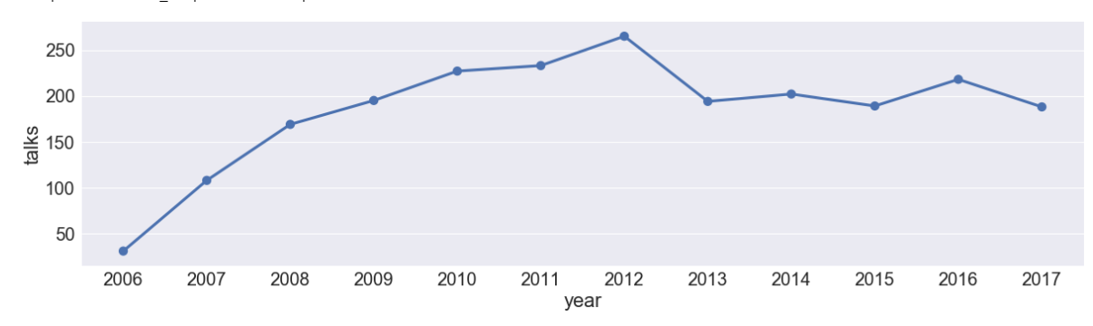
TALKS PUBLISHED PER YEAR
YEAR OF TALK | COUNT
2017 | 188
2016 | 218
2015 | 189
2014 | 202
2013 | 194
2012 | 265
2011 | 233
2010 | 227
2009 | 195
2008 | 169
2007 | 108
2006 | 31

Slide 7
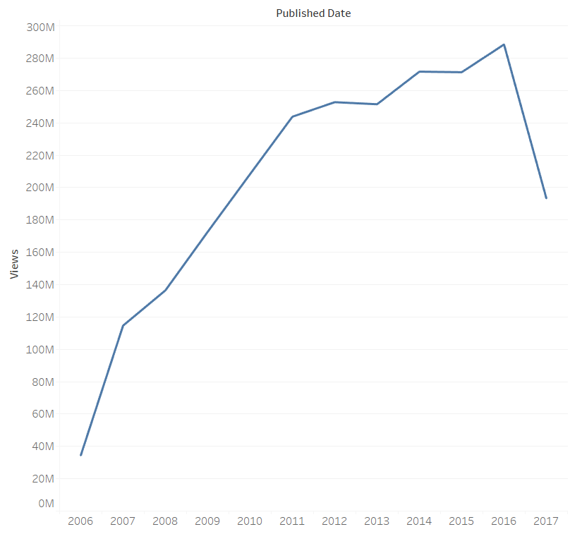
NUMBER OF VIEWS ON TALKS PER YEAR
YEAR OF PUBLISHED TALK | VIEWS
2017 | 193347468
2016 | 288468567
2015 | 271320769
2014 | 271667448
2013 | 251519100
2012 | 252798878
2011 | 243824579
2010 | 208331186
2009 | 172680908
2008 | 136456848
2007 | 114675036
2006 | 34413432

Slide 8
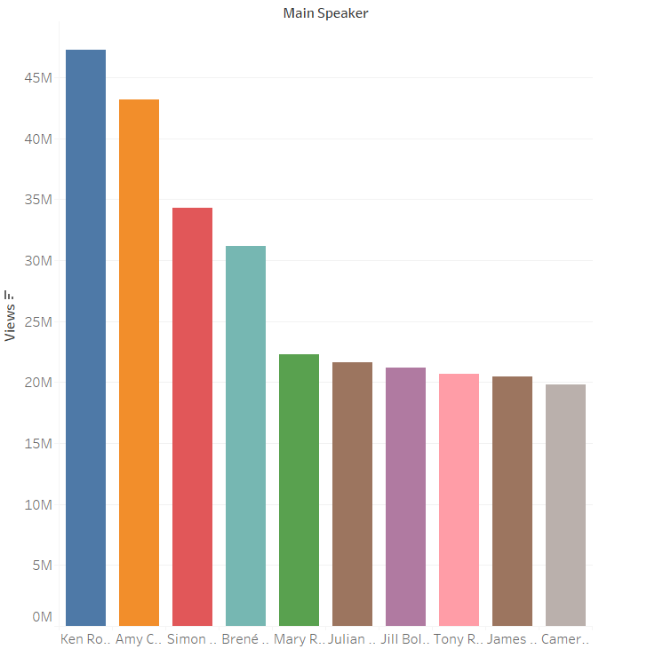
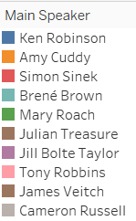
TOP 10 NAMES OF SPEAKERS BASED ON NUMBER OF VIEWS

Slide 9
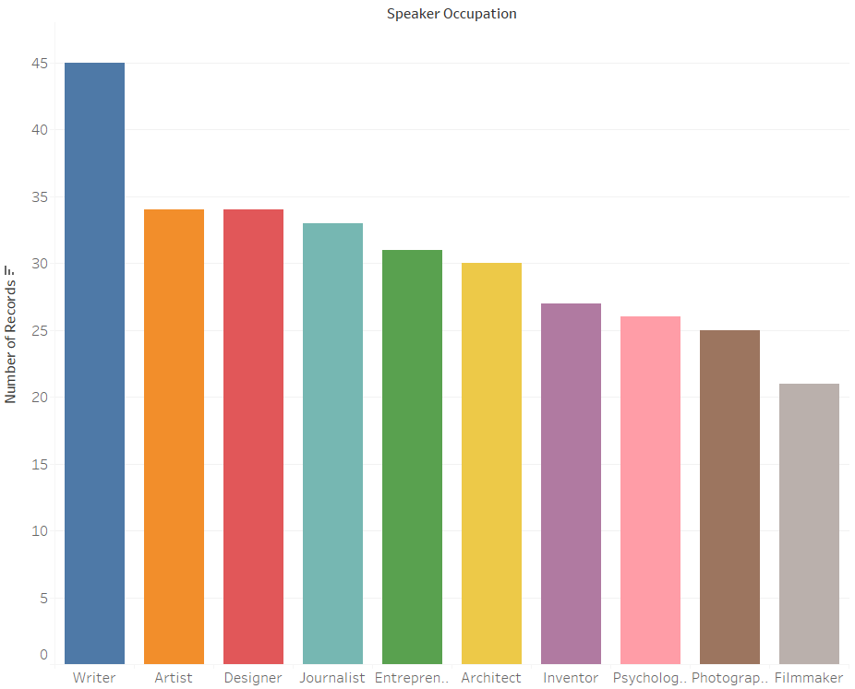
OCCUPATION OF SPEAKERS WITH MAXIMUM VIEWS

Slide 10
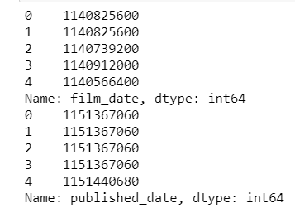
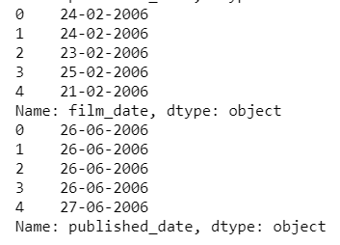
PRE-PROCESSING

Slide 11
Pre-processing
OUTLIERS WERE REMOVED FROM THE DATASET.
‘VIEWS’ COLUMN HAS BEEN DIVIDED IN TWO PARTS ON THE BASIS OF MEDIAN.
THE NEW COLUMN ‘VIEWS TYPE’ HAS TWO VALUES : 1 (HIGH VIEWS) OR -1 (LOW VIEWS)
VIEWS TYPE | COUNT
-1 | 1232
1 | 987

Slide 12
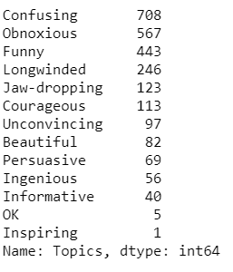
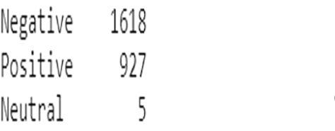
Pre-processing

Slide 13
PREDICTORS AND CLASS Attribute
PREDICTION NUMBER | CLASS | PREDICTOR 1 | PREDICTOR 2 | PREDICTOR 3 | PREDICTOR 4 | PREDICTOR 5
1 | VIEWS TYPE | LANGUAGES | COMMENTS | DURATION | RATED AS | NUMBER OF SPEAKERS
2 | RATED AS | VIEW TYPE | LANGUAGES | COMMENTS | DURATION | NUMBER OF SPEAKERS

Slide 14
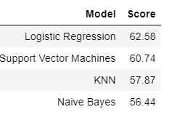
CLASSIFICATION MODEL - PREDICTION 1

Slide 15
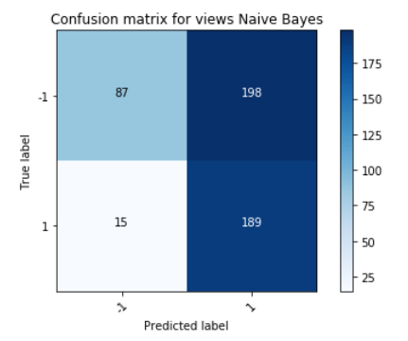

NAÏVE BAYES

Slide 16
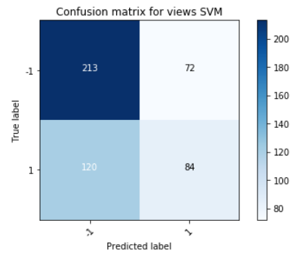

SUPPORT VECTOR MACHINE

Slide 17
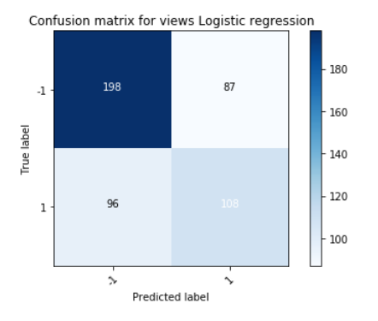

LOGISTIC REGRESSION

Slide 18
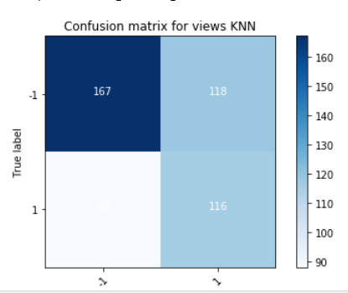

K- NeArest Neighbor (KNN)
88

Slide 19
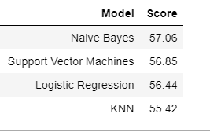
CLASSIFICATION MODEL - PREDICTION 2

Slide 20
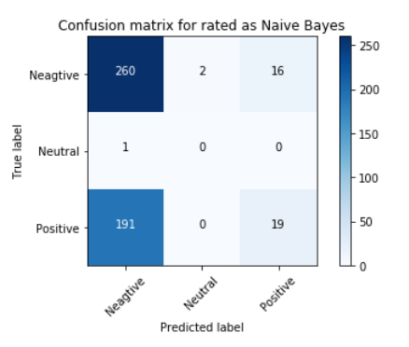

NAÏVE BAYES

Slide 21
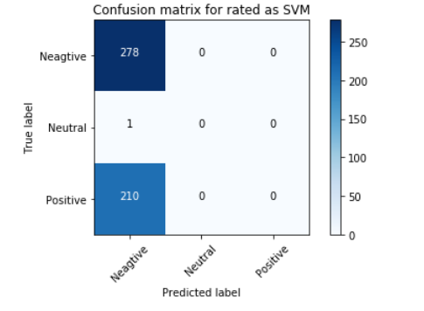

SUPPORT VECTOR MACHINE

Slide 22
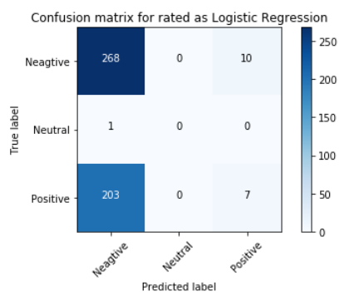

Logistic regression

Slide 23
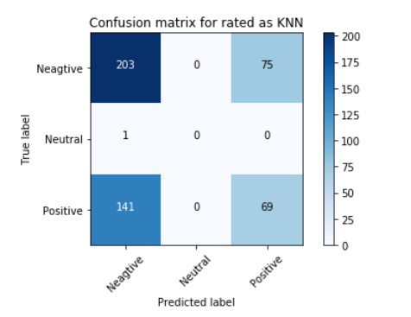

K-NeArest Neighbour (knn)

Slide 24
conclusions
For number of views prediction the best model is Logistic Regression.
For rated as prediction the best model is Naïve Bayes.

Slide 25
THANK YOU ☺

